Slide 2
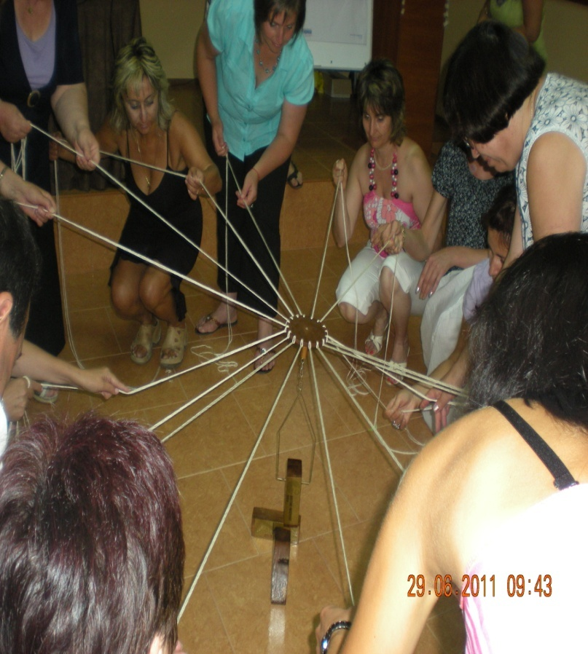
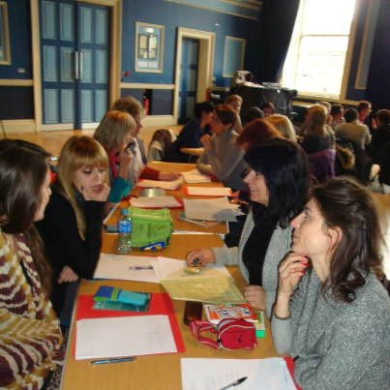
Educational Academy
We can more together…

Slide 3
“Genarations-hand in hand” eco-camp-NA

Slide 4
Teachers strive to make the school more attractive territory and desirable area for students.
Each teacher
is committed to create a cozy and
creative atmosphere in the
classroom.

Slide 5
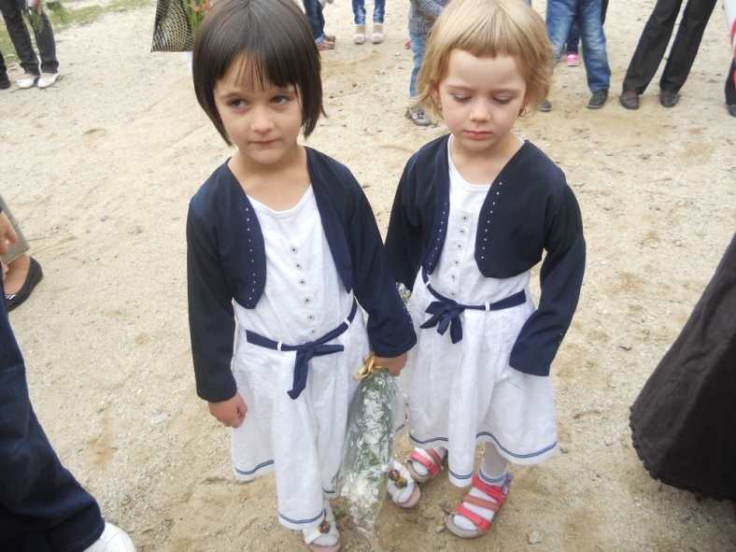
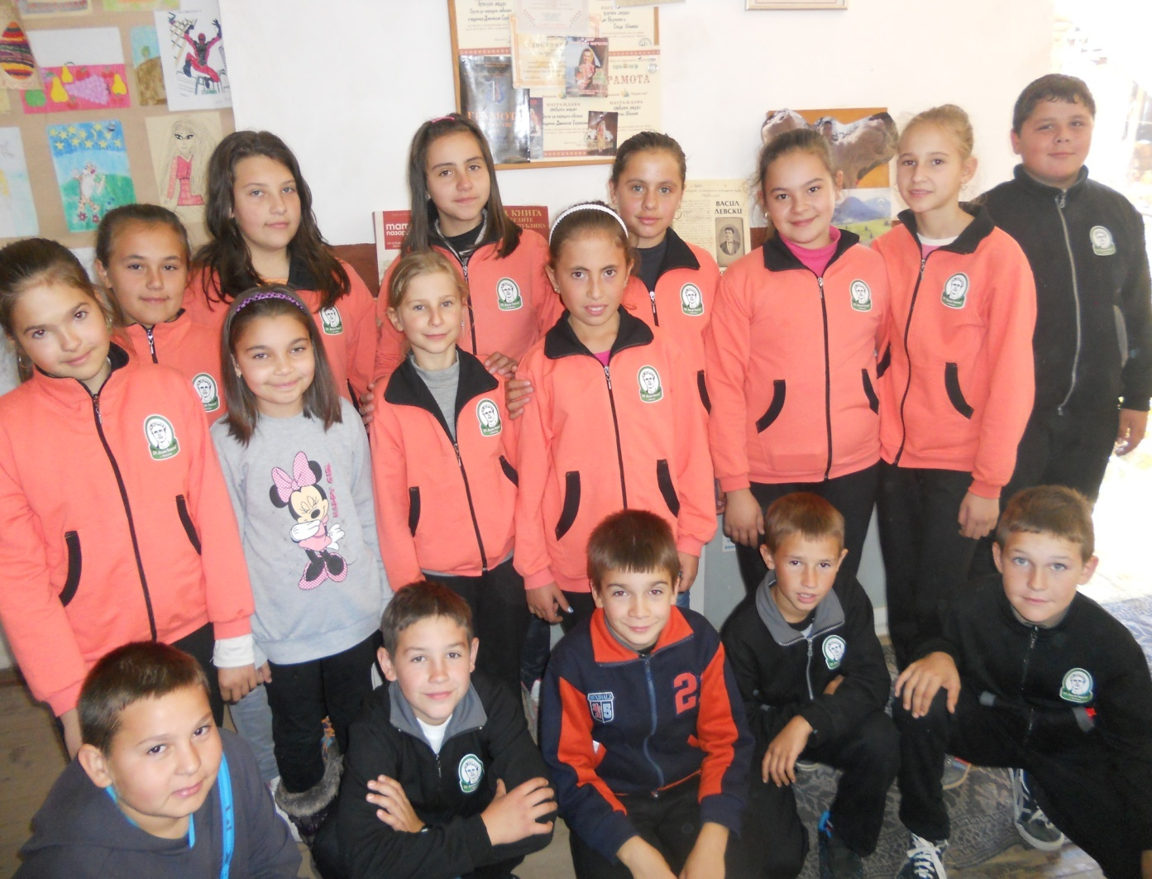
FOR STUDENTS
Here students are trained in two stages, initial stage and main stage.

Slide 6
Our students have not the advantage of living in a big city and have all of them new, but the expense, they have the opportunity to live in a place where violence, crime and drugs are foreign to people!!!

Slide 7
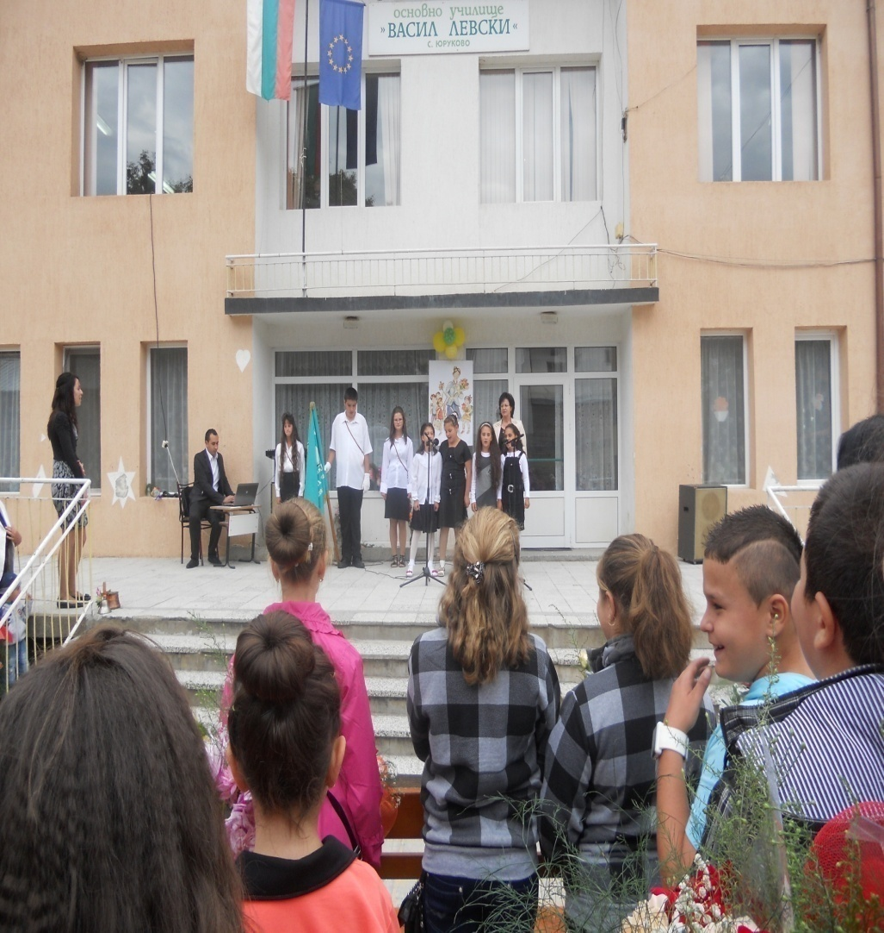
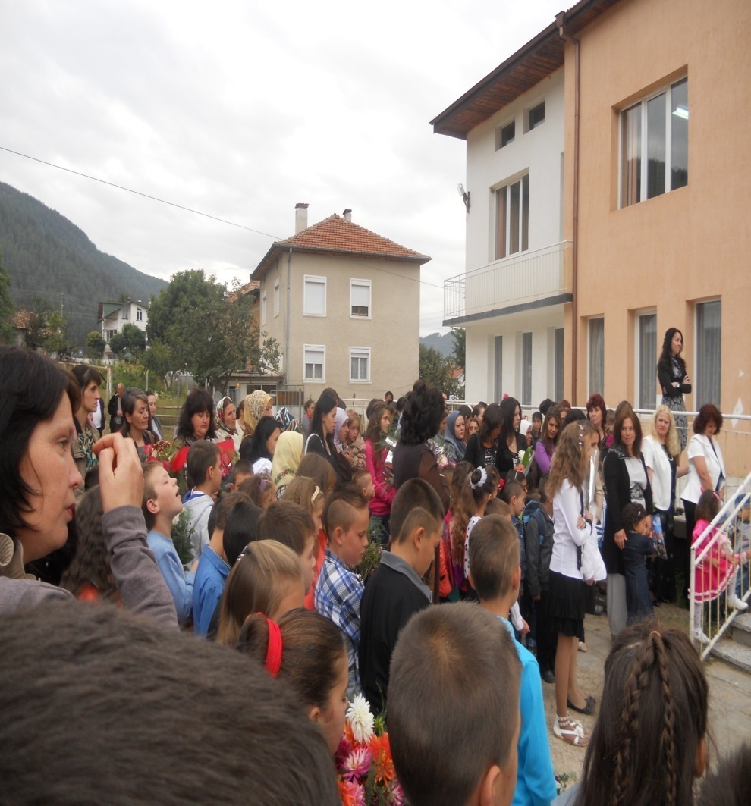
For them the most important things are family, friends, school and society.

Slide 8
Therefore, we decided that we can join the project, which is connected with future. And why now? We know 2013 is an European year of active citizenship and we want to have real opportunity to build our future and learn more about other countries and cultures.

Slide 9
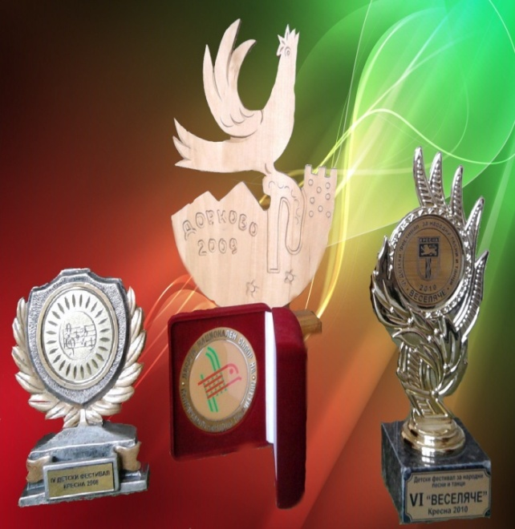
Our school takes part in activities such as competitions, festivals and projects.
Мany positive emotions brоught a draft of a “Music- Way to Child's Heart“- national project

Slide 10
